Slide 1
Introduction to Data Communication and Computer Networks
UNIT 1

Slide 2
Internet basics
Network of networks.
The internet is the global system of interconnected computer networks that uses the Internet Protocol suite (TCP/IP) to communicate between networks and devices.
It is a network of networks that consists of private, public, academic, business, and government networks of local to global scope, linked by a broad array of electronic, wireless, and optical networking technologies.
The Internet carries a vast range of information resources and services, such as the inter-linked hypertext documents and applications of the World Wide Web (WWW), electronic mail, telephony, and file sharing.

Slide 3
Network Components
Computer networks components comprise both physical parts as well as the software required for installing computer networks, both at organizations and at home.
The hardware components are the server, client, peer, transmission medium, and connecting devices. The software components are operating system and protocols.

Slide 4
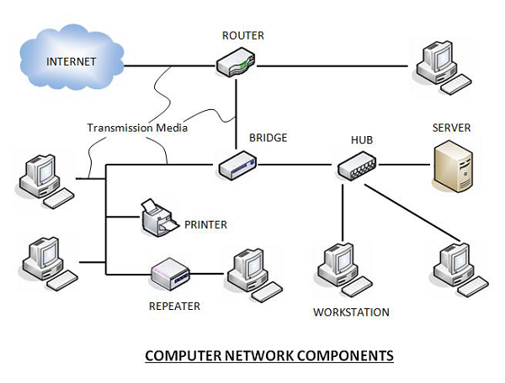
Network Components

Slide 5
Network Components
Hardware Components
Servers −Servers are high-configuration computers that manage the resources of the network.
The network operating system is typically installed in the server and so they give user accesses to the network resources.
Servers can be of various kinds: file servers, database servers, print servers etc.

Slide 6
Network Components
Clients − Clients are computers that request and receive service from the servers to access and use the network resources.
Peers − Peers are computers that provide as well as receive services from other peers in a workgroup network.
Transmission Media − Transmission media are the channels through which data is transferred from one device to another in a network.
Transmission media - guided media like coaxial cable, fibre optic cables etc ; unguided media like microwaves, infra-red waves etc.

Slide 7
Network Components
Software Components
Networking Operating System − Network Operating Systems is typically installed in the server and facilitate workstations in a network to share files, database, applications, printers etc.
Protocol Suite − A protocol is a rule or guideline followed by each computer for data communication. Protocol suite is a set of related protocols that are laid down for computer networks.
The two popular protocol suites are −
a. OSI Model ( Open System Interconnections)
b. TCP / IP Model

Slide 8
Network Components
Connecting Devices − Connecting devices act as middleware between networks or computers, by binding the network media together.
Some of the common connecting devices are:
a. Routers
b. Bridges
c. Hubs
d. Repeaters
e. Gateways
f. Switches

Slide 9
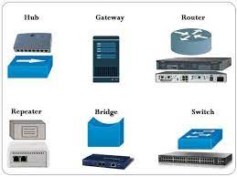
Network Components
Connecting Devices

Slide 10
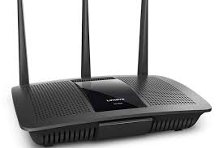
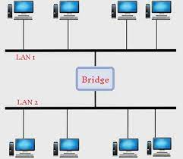
Network Components
Routers:
Routers help you to connect with multiple networks.
It enables you to share a single internet connection
with multiple devices.
This networking component acts as a dispatcher, which allows you to analyze data sent across a network.
It automatically selects the best route for data to travel and send it on its way.
Bridges:
Bridge is a network device which works in data link layer.
Bridge connects two different LAN working on same
protocol.
Also In bridge, format of packet is not changed.

Slide 11
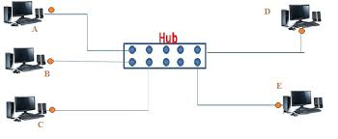
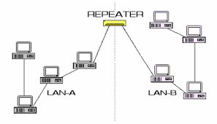
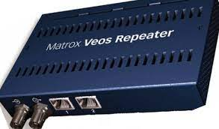
Network Components
Hubs:
Hub is a device that splits network connection
into multiple computers.
It acts a distribution center so whenever a computer
requests any information from a computer or from
the network it sends the request to the hub through
a cable.
The hub will receive the request and transmit it to the entire network.
A hub is a standard network point, to connect devices in a network. The hub has numerous ports.
Repeaters
A repeater operates at the physical layer.
Repeater amplifies the received signal and retransmits the
signals in the same network before the signal becomes too
weak or corrupted .
When the signal becomes weak, they copy the signal bit by
bit and regenerate it at the original strength.
It is a 2 port device.

Slide 12
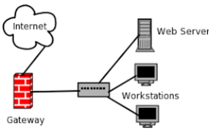
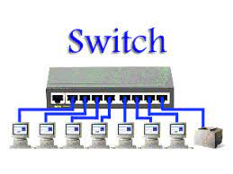
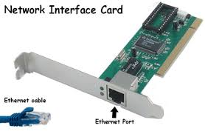
Network Components
Gateways:
Gateway works in OSI model’s all layer.
It converts the protocol. Gateway will settle for
and transfer the packet across networks employing
a completely different protocol.
In gateway, format of packet is changed which oppose to the bridge.
Switches :
Switches work as a controller which connects computers,
printers, and other hardware devices to a network in
a campus or a building.
It allows devices on your network to communicate with
each other, as well as with other networks.
It helps you to share resources and reduce the costing of
any organization.
Network Interface Card:
Network Interface card sends, receives data, and controls data flow
between the computer and the network.

Slide 13
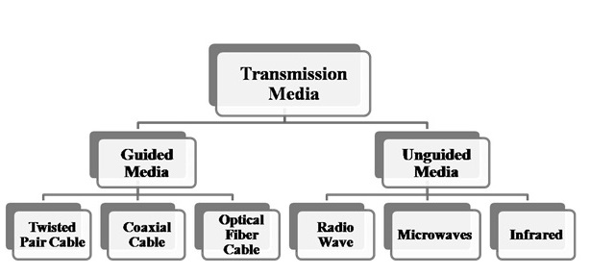
Transmission Media

Slide 14
Transmission Media
In data communication terminology, a transmission medium is a physical path between the transmitter and the receiver i.e. it is the channel through which data is sent from one place to another.
When two devices wants to communicate, at that time communication channel they used is called transmission media.
Guided Media:
- It is also referred to as Wired or Bounded transmission media.
- Guided transmission media are cables that are tangible or have physical existence.
- Wired transmission media use cable or wires for sending the data from one place to another.
- Signals being transmitted are directed in a narrow pathway by using physical links.
- In this media data guide goes through cables from one place to another.
- The data signals are bounded by the cabling system, that’s why it is also known as Bounded
transmission media.
Features:
High Speed
Secure
Used for comparatively shorter distances

Slide 15
Transmission Media
Types of Guided Media
Twisted Pair Cable
Coaxial Cable
Optical Fiber Cable

Slide 16
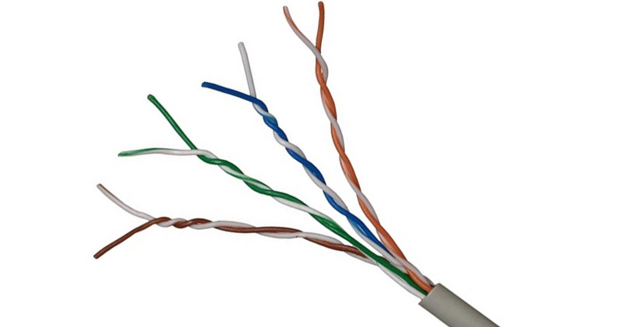
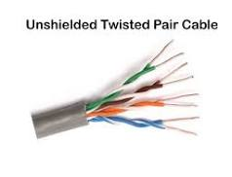
Transmission Media
(i) Twisted Pair Cable
- Twisted Pair are the most widely used Transmission Media.
- It is light weight , easy to install, inexpensive ,and support data
speed up to 100 Mbps.
- It consists of 2 separately insulated conductor wires wound about each other.
- Several such pairs are bundled together in a protective sheath.
- A twisted pair cable consists of two conductors (copper) ,each pair of cable
twisted together to form a single media with its own plastic insulation.
- Out of these two wires, one wires carries the actual signal and other one is used
for ground references.
- To identify each cable ,these cables are color-coated.
- A twist between the wires is helpful in reducing the noise and crosstalk.
Twisted Pair is of two types:
Unshielded Twisted Pair (UTP):
- UTP consists of two insulated copper wires twisted around one another.
- There is no shield in UTP, means no metal foil.
- This type of cable has the ability to block interference
and does not depend on a physical shield for this purpose.
- UTP cable is more common than STP cables ,because its cost is less than STP.
- It is widely used for LAN and telephonic connection.

Slide 17
Transmission Media
Advantages:
- Least expensive
- Easy to install
- High-speed capacity
Disadvantages:
- Susceptible to external interference.
- Lower capacity and performance in comparison to STP.
- Short distance transmission due to attenuation.
Applications:
- Used in telephone connections and LAN networks.

Slide 18
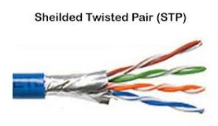
Transmission Media
Shielded Twisted Pair (STP):
- This type of cable consists of a special jacket (a copper covering or
a foil shield) to block external interference.
- It is used in fast-data-rate Ethernet and in voice and data channels of
telephone lines.
Advantages:
- Better performance at a higher data rate in comparison to UTP
- Eliminates crosstalk
- Comparatively faster
Disadvantages:
- Comparatively difficult to install and manufacture
- More expensive
- Bulky
Applications:
- The shielded twisted pair type of cable is most frequently used in extremely cold climates, where the additional layer of outer
covering makes it perfect for withstanding such temperatures or for shielding the interior components.

Slide 19
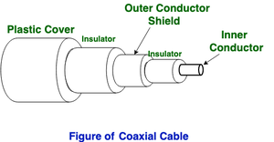
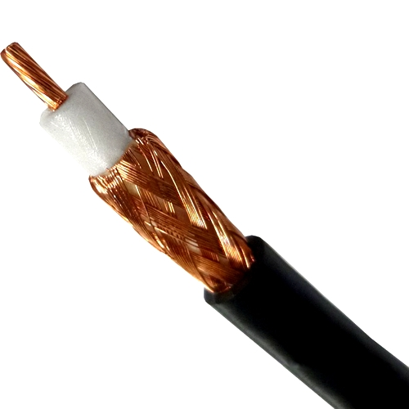
Transmission Media
(ii)Coaxial Cable - It has an outer plastic covering containing an insulation layer made of PVC or
Teflon.
- 2 parallel conductors each having a separate insulated protection cover.
- The coaxial cable transmits information in two modes: Baseband mode(dedicated
cable bandwidth) and Broadband mode(cable bandwidth is split into separate
ranges).
- Cable TVs and analog television networks widely use Coaxial cables.

Slide 20
Transmission Media
Advantages:
- High Bandwidth
- Better noise Immunity
- Easy to install and expand
- Inexpensive
Disadvantages:
- Single cable failure can disrupt the entire network
Applications:
Radio frequency signals are sent over coaxial wire. It can be used for cable television signal distribution, digital audio , computer network connections (like Ethernet.

Slide 21
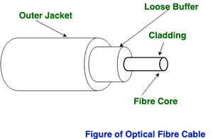
Transmission Media
(iii) Optical Fiber Cable
- It uses the concept of refraction of light through a core made up of glass or plastic.
- The core is surrounded by a less dense glass or plastic covering called the cladding.
- It is used for the transmission of large volumes of data.
- The cable can be unidirectional or bidirectional.
Advantages:
- Increased capacity and bandwidth
- Lightweight
- Less signal attenuation
- Immunity to electromagnetic interference
Disadvantages:
- Difficult to install and maintain
- High cost
- Fragile
Applications:
Optical fiber is used by telecommunications companies to transmit telephone signals, Internet communication and cable television signals. It is also used in other industries, including medical, defense, government, industrial and commercial.

Slide 22
Transmission Media
2. Unguided Media:
- It is also referred to as Wireless or Unbounded transmission media.
- No physical medium is required for the transmission of electromagnetic
signals.
Features:
The signal is broadcasted through air.
Less Secure.
Used for larger distances.

Slide 23
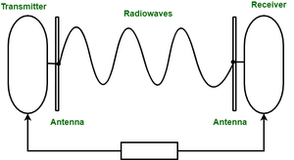
Transmission Media
There are 3 types of Signals transmitted through unguided media:
Radio waves :
- Radio waves are transmitted in every direction throughout free space.
- These are easy to generate and can penetrate through buildings.
- Omnidirectional, sent waves can be received by any antenna.
- The sending and receiving antennas need not be aligned.
- These waves are useful when the data is to multi-casted from one sender to multiple
receivers.
- Frequency Range:3KHz – 1GHz. AM and FM radios and cordless phones
use Radio waves for transmission.
Ex: FM Radio.

Slide 24
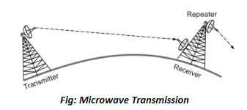
Transmission Media
(ii) Microwaves
- It is a line of sight transmission i.e. the sending and receiving antennas need to be
properly aligned with each other.
- The distance covered by the signal is directly proportional to the height of the
antenna.
- Suitable for shorter distances.
- They comprise of electromagnetic waves
- Frequency Range:1GHz – 300GHz. These are majorly used for mobile phone
communication and television distribution.

Slide 25
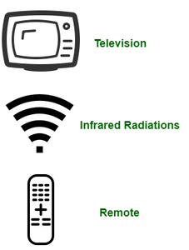
Transmission Media
(iii) Infrared - Infrared waves are used for very short distance communication.
- They cannot penetrate through obstacles.
- This prevents interference between systems and more secure.
- Frequency Range:300GHz – 400THz.
- It is used in TV remotes, wireless mouse, keyboard, printer, etc.

Slide 26
Various types of Networks
LAN (Local Area Network)
PAN (Personal Area Network)
CAN (Campus Area Network)
MAN (Metropolitan Area Network)
WAN (Wide Area Network)
SAN (Storage Area Network)
EPN (Enterprise Private Network)
VPN (Virtual Private Network)
HAN (Home Area Network)

Slide 27
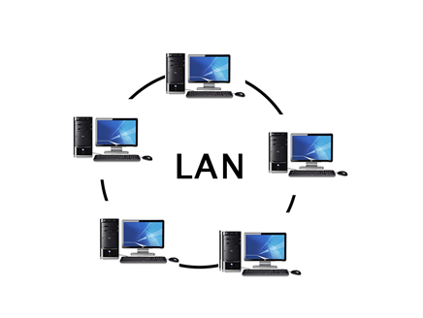
Various types of Networks
LAN(Local Area Network)
Local Area Network is a group of computers
connected to each other in a small area such
as building, office.
LAN is used for connecting two or more personal computers through a communication medium such as twisted pair, coaxial cable, etc.
It is less costly as it is built with inexpensive hardware such as hubs, network adapters, and ethernet cables.
The data is transferred at an extremely faster rate in Local Area Network.
Local Area Network provides higher security.

Slide 28
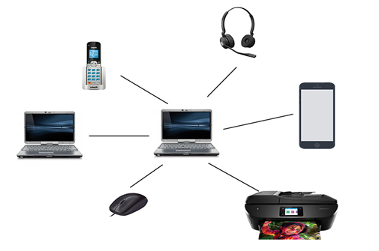
Various types of Networks
PAN(Personal Area Network)
Personal Area Network is a network
arranged within an individual person,
typically within a range of 10 meters.
Personal Area Network is used for connecting the computer devices of personal use is known as Personal Area Network.
Personal Area Network covers an area of 30 feet.
Personal computer devices that are used to develop the personal area network are the laptop, mobile phones, media player and play stations.

Slide 29
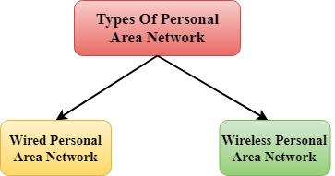
Various types of Networks
There are two types of Personal Area Network:
Wired Personal Area Network
Wireless Personal Area Network
Wireless Personal Area Network: Wireless Personal Area Network is developed by simply using wireless technologies such as WiFi, Bluetooth. It is a low range network.
Wired Personal Area Network: Wired Personal Area Network is created by using the USB.

Slide 30
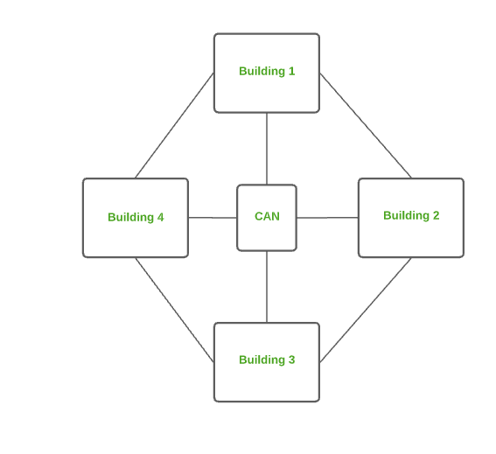
Various types of Networks
CAN (Campus Area Network)
CAN is bigger than a LAN but
smaller than a MAN.
This is a type of computer network which is usually used in places like a school or college.
This network covers a limited geographical area that is, it spreads across several buildings within the campus.
Ex:- Networks that cover schools, colleges, buildings, etc.

Slide 31
Various types of Networks
MAN(Metropolitan Area Network)
A metropolitan area network is a network that covers a larger geographic area by interconnecting a different LAN to form a larger network.
Government agencies use MAN to connect to the citizens and private industries.
In MAN, various LANs are connected to each other through a telephone exchange line.
The most widely used protocols in MAN are RS-232, Frame Relay, ATM, ISDN, OC-3, ADSL, etc.
It has a higher range than Local Area Network(LAN).

Slide 32
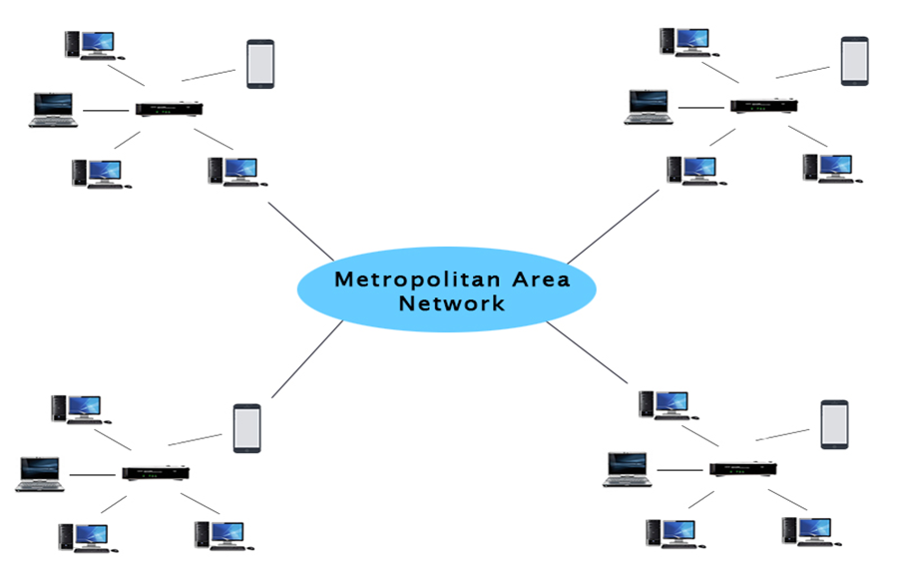
Various types of Networks
MAN is used in communication between the banks in a city.
It can be used in an Airline Reservation.
It can be used in a college within a city.
It can also be used for communication in the military.

Slide 33
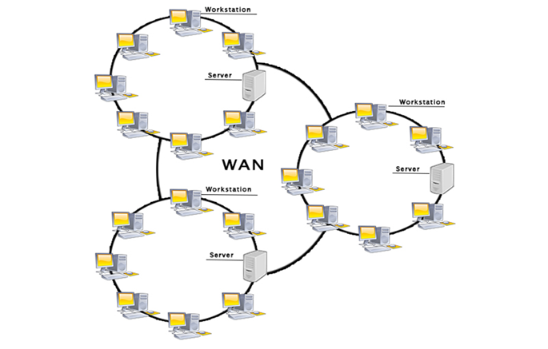
Various types of Networks
WAN(Wide Area Network)
A Wide Area Network is a network that
extends over a large geographical area
such as states or countries.
A Wide Area Network is quite bigger
network than the LAN.
A Wide Area Network is not limited to a single location, but it spans over a large geographical area through a telephone line, fiber optic cable or satellite links.
The internet is one of the biggest WAN in the world.
A Wide Area Network is widely used in the field of Business, government, and education.

Slide 34
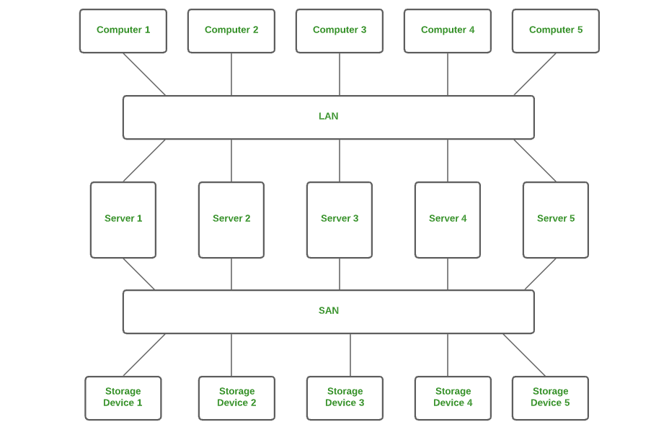
Various types of Networks
SAN (Storage Area Network)
SAN is a type of computer network that
is high speed and connects groups of
storage devices to several servers.
This network does not depend on LAN or WAN.
Instead, a SAN moves the storage resources from the network to its own high-powered network.
A SAN provides access to block-level data storage.
Ex: Network of disks accessed by a network of servers.

Slide 35
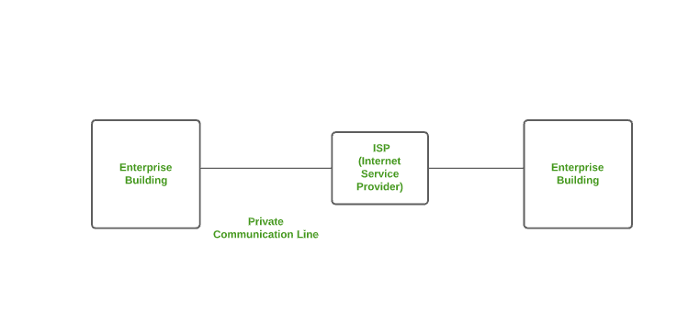
Various types of Networks
Enterprise Private Network (EPN)
EPN is a type of computer network mostly used by businesses that want a secure connection over various locations to share computer resources.

Slide 36
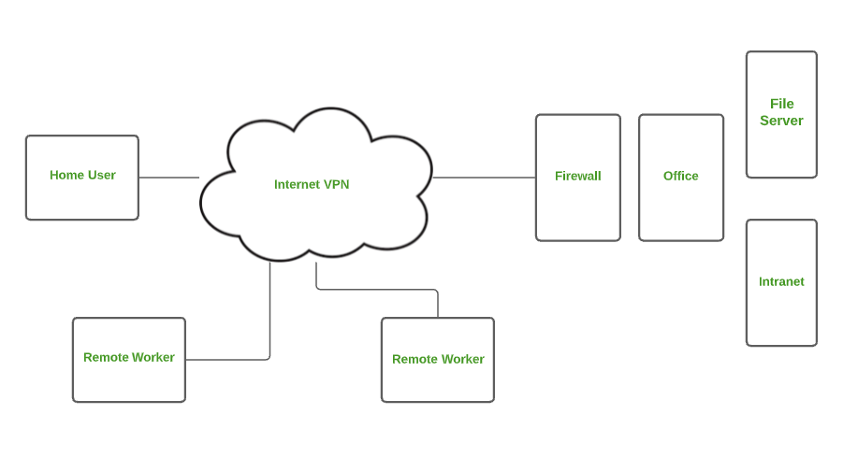
Various types of Networks
VPN (Virtual Private Network)
A VPN is a type of computer network that extends a private network across the internet and lets the user send and receive data as if they were connected to a private network even though they are not.
Through a virtual point-to-point connection users can access a private network remotely.
VPN protects you from malicious sources by operating as a medium that gives you a protected network connection.

Slide 37
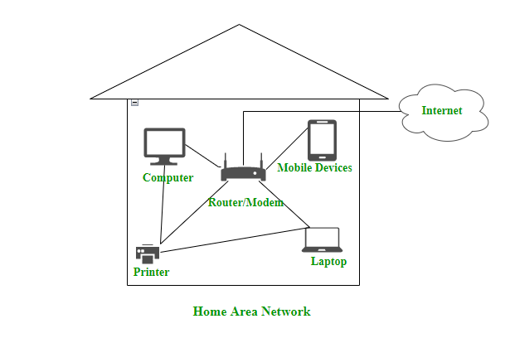
Various types of Networks
Home Area Network (HAN)
Many of the houses might have more
than a computer.
To interconnect those computers and with
other peripheral devices, a network should
be established similar to the local area network
(LAN) within that home.
Such a type of network that allows a user to interconnect multiple computers and other digital devices within the home is referred to as Home Area Network (HAN).
HAN encourages sharing of resources, files, and programs within the network. It supports both wired and wireless communication.

Slide 38
Connection Oriented N/Ws Vs Connectionless N/Ws
Data communication is a telecommunication network to send and receive data between two or more computers over the same or different network.
There are two ways to establish a connection before sending data from one device to another, that are Connection-Oriented and Connectionless Service.
Connection-oriented service involves the creation and termination of the connection for sending the data between two or more devices.
In contrast, connectionless service does not require establishing any connection and termination process for transferring the data over a network.

Slide 39
Connection Oriented N/Ws Vs Connectionless N/Ws
Connection-Oriented Service
A connection-oriented service is used to create an end to end connection between the sender and the receiver before transmitting the data over the same or different networks.
In connection-oriented service, packets are transmitted to the receiver in the same order the sender has sent them.
It uses a handshake method that creates a connection between the user and sender for transmitting the data over the network.
It is also known as a reliable network service.

Slide 40
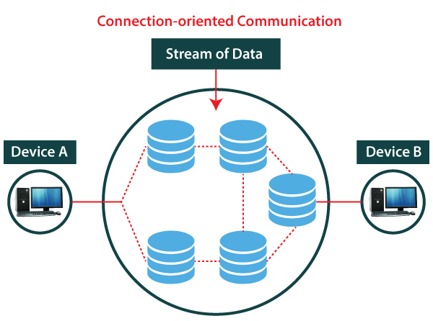
Connection Oriented N/Ws Vs Connectionless N/Ws
Suppose, a sender wants to send data to the receiver.
Then, first, the sender sends a request packet to a
receiver in the form of an SYN packet.
After that, the receiver responds to the sender's
request with an (SYN-ACK) signal/packets.
That represents the confirmation is received by the
receiver to start the communication between the
sender and the receiver.
Now a sender can send the message or data to the receiver.
Similarly, a receiver can respond or send the data to the sender in the form of packets.
After successfully exchanging or transmitting data, a sender can terminate the connection by sending a signal to the receiver.
In this way, we can say that it is a reliable network service.

Slide 41
Connection Oriented N/Ws Vs Connectionless N/Ws
Connectionless Service
A connection is similar to a postal system, in which each letter takes along different route paths from the source to the destination address.
Connectionless service is used in the network system to transfer data from one end to another end without creating any connection.
So it does not require establishing a connection before sending the data from the sender to the receiver.
It is not a reliable network service because it does not guarantee the transfer of data packets to the receiver, and data packets can be received in any order to the receiver.
Therefore we can say that the data packet does not follow a defined path.
In connectionless service, the transmitted data packet is not received by the receiver due to network congestion, and the data may be lost.

Slide 42
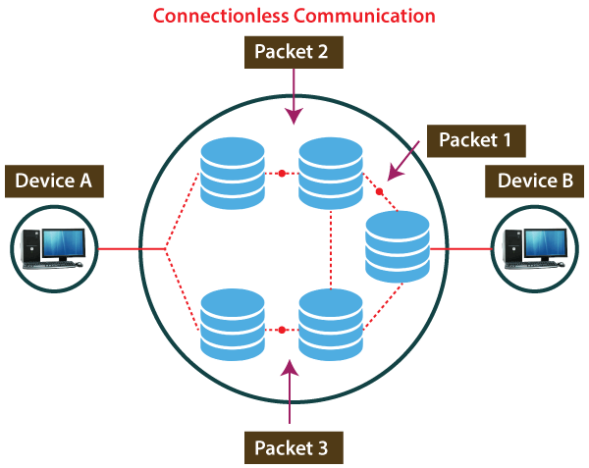
Connection Oriented N/Ws Vs Connectionless N/Ws
Ex: A sender can directly send any data to the
receiver without establishing any connection
because it is a connectionless service.
Data sent by the sender will be in the packet or
data streams containing the receiver's address.
In connectionless service, the data can be travelled
and received in any order.
It does not guarantee to transfer of the packets to the right destination.

Slide 43
Connection Oriented N/Ws Vs Connectionless N/Ws
Connection-oriented Service | Connection Less Service
It is designed and developed based on the telephone system. | It is service based on the postal system.
It is used to create an end to end connection between the senders to the receiver before transmitting the data over the same or different network. | It is used to transfer the data packets between senders to the receiver without creating any connection.
It creates a virtual path between the sender and the receiver. | It does not create any virtual connection or path between the sender and the receiver.
It requires authentication before transmitting the data packets to the receiver. | It does not require authentication before transferring data packets.
All data packets are received in the same order as those sent by the sender. | Not all data packets are received in the same order as those sent by the sender.
It is a more reliable connection service | It is not a reliable connection service
There is no congestion as it provides an end-to-end connection between sender and receiver | There may be congestion due to not providing an end-to-end connection between the source and receiver
Transmission Control Protocol (TCP) is an example of a connection-oriented service. | User Datagram Protocol (UDP), Internet Protocol (IP), and Internet Control Message Protocol (ICMP) are examples of connectionless service.

Slide 44
Ethernet
Ethernet is a type of communication protocol that is created at Xerox PARC in 1973 by Robert Metcalfe and others, which connects computers on a network over a wired connection.
It is a widely used LAN protocol, which is also known as Alto Aloha Network.
It connects computers within the local area network and wide area network.
Devices like printers and laptops can be connected by LAN and WAN within buildings, homes, and even small neighborhoods.

Slide 45
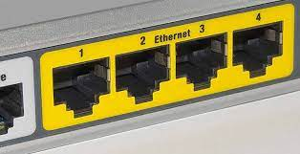
Ethernet
It offers a simple user interface that helps
to connect various devices easily, such as
switches, routers, and computers.
A local area network (LAN) can be created with the help of a single router and a few Ethernet cables, which enable communication between all linked devices.
Ethernet port is included in your laptop in which one end of a cable is plugged in and connect the other to a router.
Ethernet ports are slightly wider, and they look similar to telephone jacks.

Slide 46
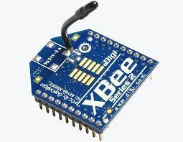
ZigBee
ZIGBEE - Zonal Intercommunication Global-standard, where Battery life is long, which is Economical to deploy, and which exhibits Efficient use of resources.
ZigBee is a Personal Area Network task group with low rate task group 4.
It is a technology of home networking.
ZigBee is a technological standard created for controlling and sensing the network.
ZigBee is based on IEEE 802.15.4 and is created by Zigbee Alliance.
ZigBee is a standard that addresses the need for very low-cost implementation of Low power devices with Low data rates for short-range wireless communications.
ZigBee operates in mesh topology, which helps the ZigBee device to transfer its message to its destination via a number of intermediate ZigBee devices
connected within the network.
A single Zigbee enabled device can reach up to a range of
10-20 meters(indoors) in search of another Zigbee device
present in the network.

Slide 47
WiFi - Wireless Fidelity
Wi-Fi is the wireless technology used to connect computers, tablets, smartphones and other devices to the internet.
Wi-Fi is available on our mobile phones, laptops, or wherever Wi-Fi is supported. Wi-Fi is a wireless networking technology that permits to connect wirelessly to a network or to other computer or mobile device. A circular radio frequency range is used to transmit data in Wi-Fi.
Wi-Fi is the radio signal sent from a wireless router to a nearby device, which translates the signal into data you can see and use.
The device transmits a radio signal back to the router, which connects to the internet by wire or cable.

Slide 48
WiFi - Wireless Fidelity
A WiFi network is simply an internet connection that’s shared with multiple devices in a home or business via a wireless router.
The router is connected directly to your internet modem and acts as a hub to broadcast the internet signal to all your Wi-Fi enabled devices.
Wifi operates like a local area network without the use of a wire or cables.

Slide 49
Access Technique -CSMA-CD
CSMA/CD (Carrier Sense Multiple Access/ Collision Detection) is a media access control method that was widely used in Early Ethernet technology/LANs .
Bus Topology and each node (Computers) were connected By Coaxial Cables.
Now a Days Ethernet is Full Duplex and CSMA/CD is not used as Topology is either Star (connected via Switch or Router)

Slide 50
Access Technique -CSMA-CD
Collision Detection in CSMA/CD
Consider a scenario where there are ‘n’ stations on a link and all are waiting to transfer data through that channel.
In this case, all ‘n’ stations would want to access the link/channel to transfer their own data.
Problem arises when more than one station transmits the data at the moment.
In this case, there will be collisions in the data from different stations.

Slide 51
Access Technique -CSMA-CD
Collision Detection in CSMA/CD
CSMA/CD is one such technique where different stations that follow this protocol agree on some terms and collision detection measures for effective transmission.
This protocol decides which station will transmit when so that data reaches the destination without corruption.
How CSMA/CD works?
Step 1: Check if the sender is ready for transmitting data packets.
Step 2: Check if the transmission link is idle?
Step 3: Transmit the data & check for collisions.
Step 4: If no collision was detected in propagation, the sender completes its frame transmission and resets the counters.

Slide 52
Access Technique -CSMA-CD
Following are the three types of multiple access techniques:
FDMA (Frequency Division Multiple Access)
TDMA (Time Division Multiple Access)
CDMA (Code Division Multiple Access)

Slide 53
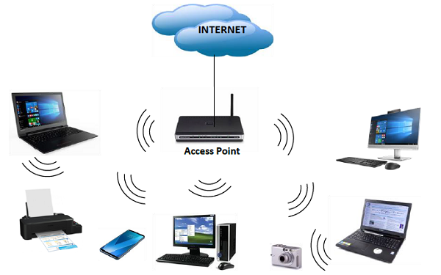
Wireless Network
Computer networks that are not connected by cables are called wireless networks.
They generally use radio waves for communication between the network nodes.
They allow devices to be connected to the network while roaming around within the network coverage.

Slide 54
Wireless Network
Types of Wireless Network:
Wireless LANs − Connects two or more network devices using wireless distribution techniques.
Wireless MANs − Connects two or more wireless LANs spreading over a metropolitan area.
Wireless WANs − Connects large areas comprising LANs, MANs and personal networks.

Slide 55
Wireless Network
Advantages of Wireless Networks
It provides clutter-free desks due to the absence of wires and cables.
It increases the mobility of network devices connected to the system since the devices need not be connected to each other.
Accessing network devices from any location within the network coverage or Wi-Fi hotspot becomes convenient since laying out cables is not needed.
Installation and setup of wireless networks are easier.
New devices can be easily connected to the existing setup since they needn’t be wired to the present equipment.
Number of equipment can be added or removed to the system can vary considerably since they are not limited by the cable capacity. This makes wireless networks very scalable.
Wireless networks require very limited or no wires. Thus, it reduces the equipment and setup costs.

Slide 56
Wireless Network
Examples of wireless networks
Mobile phone networks
Wireless sensor networks
Satellite communication networks
Terrestrial microwave networks

Slide 57
Unified Communication –VOIP
Voice over Internet Protocol (VoIP), is a technology that allowing you to make voice calls over a broadband Internet connection instead of an analog (regular) phone line.
Some VoIP services allow you to call people using the same service, but others may allow you to call anyone.
They can have a telephone number – including local, long-distance, mobile, and international numbers or not.
Some VoIP services only work over your computer or a special VoIP phone while other services allow you to use a traditional phone connected to a VoIP adapter.

Slide 58
Unified Communication –VOIP
How VoIP / Internet Voice Works
Voice is converted into a digital signal by VoIP services that travel over the Internet.
If the regular phone number is called, the signal is converted to a regular telephone signal i.e. an analog signal before it reaches the destination.
VoIP can allow you to make a call directly from a computer having a special VoIP phone, or a traditional phone connected to a special adapter.
Wireless hot spots in locations such as airports, hospitals, cafes, etc allow you to connect to the Internet and can enable you to use VoIP service wirelessly.

